Slide 1

Uber Trip Analysis
Ramireddy Devendranath Reddy

Slide 2
Agenda
1
2
3
4
5
Introduction
Objective
Methodology of Prediction
Inferences
References

Slide 3

Introduction
Analyzing Uber trips according to the given data and criteria.
Understanding the business model can help identify challenges that can be solved using analytics and scientific data. In this article, we go through the Uber Model, which provides a framework for end-to-end prediction analytics of Uber data prediction sources.

Slide 4
Objective
Analyzing the provided Uber data in hourly, daily and weekly basis so that the data would be easily understandable form the client and will be a better prediction and to makes necessary changes.
Getting the correlation of the data on weekly vs hourly basis so that it would be better to understand about the trips.
Analyzing the density of the trips in a particular location on daily basics.

Slide 5
Methodology

Slide 6
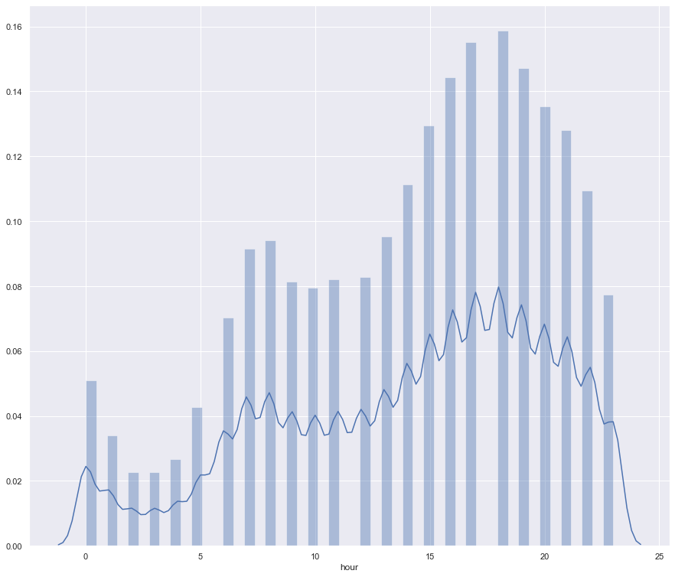
Data when the Uber trips were highest on hours basis

Slide 7
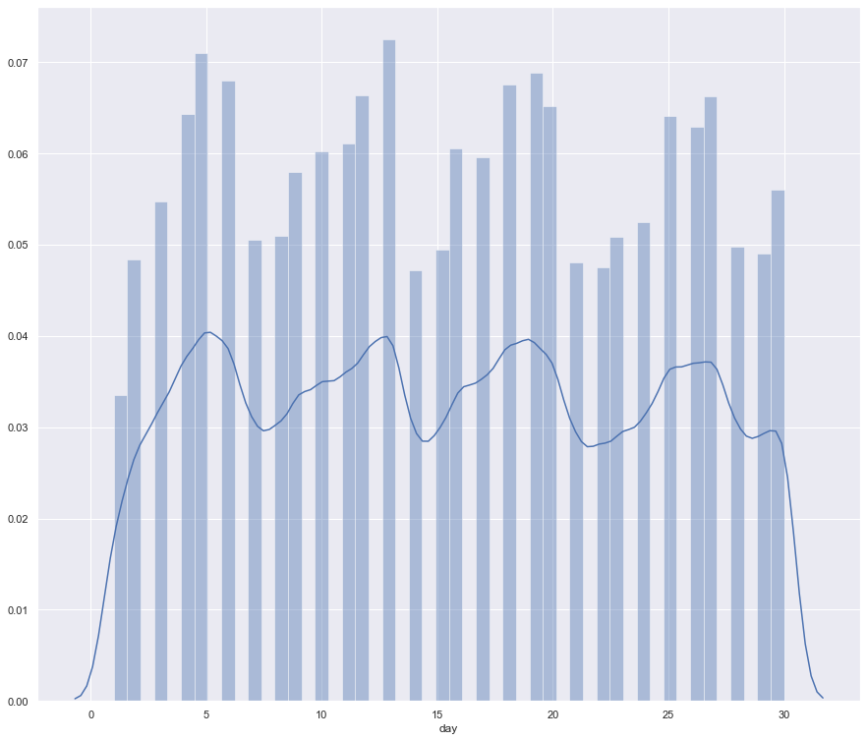
Data when the Uber trips were highest on day’s basis.

Slide 8
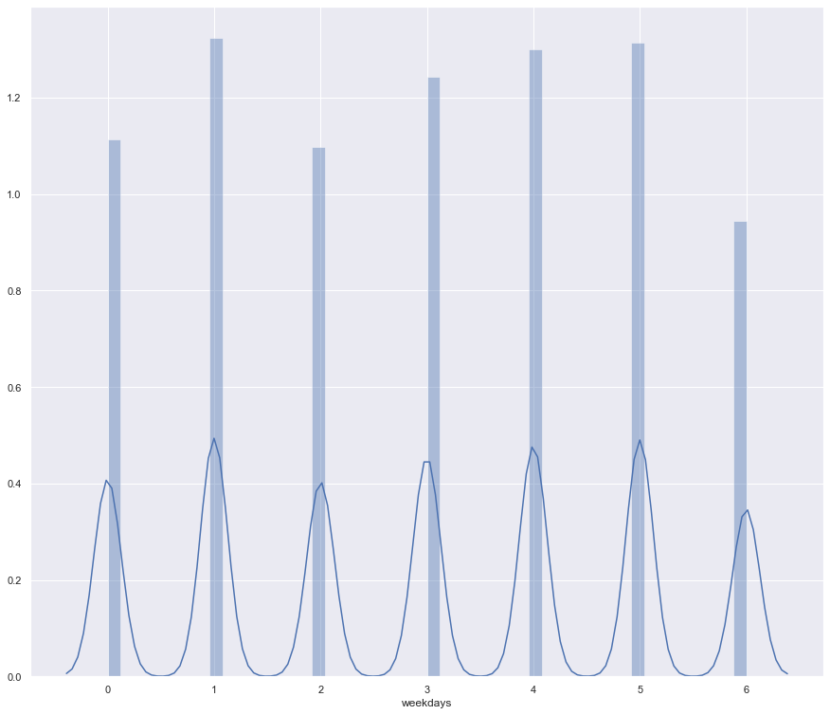
Data when the Uber trips were highest on weekly basis

Slide 9
Data of weekdays vs hour

Slide 10
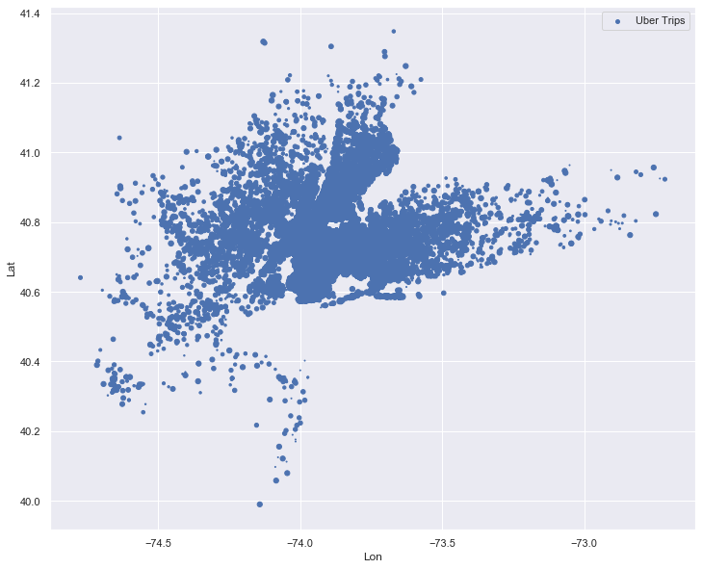
Density of trips in the city
 | B2B | Supply chain | ROI | E-commerce
Q1 | 4.5 | 2.3 | 1.7 | 5.0
Q2 | 3.2 | 5.1 | 4.4 | 3.0
Q3 | 2.1 | 1.7 | 2.5 | 2.8
Q4 | 4.5 | 2.2 | 1.7 | 70

Slide 11
Uber trips on hourly, daily and weekly basis
Correlating the data on weekly and hourly basis
Density of the trips in the city
​ ​
We have used distribution plot for analyzing the data on which hour, day and weekday was the trip highest.
Predicting the correlation of the weekdays and hourly data using a heat map which helps us to predict on which hour of which day was the trips highest.
Finding the density of the trips according to the location on daily basis which help us to predict and apply machine learning on the model.

Slide 12

Inferences
Analyzing the Uber data in hourly, daily and weekly basis.
Analyzing the Uber data by correlating the data between Weekdays and Hours basis where it shows the correlation on which day and at what hour what is the density of the trip..
Analyzing the Uber data on the density of the trips in the particular locations using scatter plot.

Slide 13
References
Kaggle – Uber Dataset
Images – Google
Graphs – Code/Git hub

Slide 14
Thank you
-Ramireddy Devendranath Reddy

